Slide 1
GHOST IT • PROJECT PRESENTATION
GHOST LAYER
An Autonomous Digital Immune System for Endpoint Defense
Behavioral AI, deception and causal reasoning work together to detect, understand and safely respond to endpoint threats.
BEHAVIORAL AI
DECEPTION
CAUSAL REASONING
AUTONOMOUS RESPONSE
Dhakshin Kumar • Keerthivahanan • Narine A • Deepak Sanjay
Guided by
S. J. Kavitha
B.Tech CSE (AI & ML)

Slide 2
Introduction / Abstract
02
Why endpoint security needs a different operating model
Ghost IT is an endpoint security platform designed around the idea of a digital immune system. Instead of relying on isolated alerts, it combines low-level endpoint telemetry with behavioral anomaly detection, deception signals and causal attack-chain reasoning. When multiple signals agree, the system can move from detection to controlled response, self-healing and verification. The architecture is designed for Indian SMEs and mid-market organizations that need stronger endpoint visibility without the infrastructure and operating cost normally associated with large enterprise security platforms. The current system demonstrates real Linux eBPF and Windows ETW telemetry, behavioral detection, ransomware response, deception, causal reasoning, observability and recovery workflows, while clearly separating experimental components and future production hardening.
<1 sec
41 / 41
0 / 10
500+ / 3s
Ransomware detection
Automated checks
Benign-test false alerts
Event processing
Ghost Layer • Ghost IT

Slide 3
Problem Statement
03
The security gap is not only detection — it is context, action and recovery
THE PROBLEM
01
Alert overload
Modern endpoints generate a large volume of security events, but an alert alone does not explain whether an activity is malicious, how it connects to other actions, or what should happen next. Indian SMEs also face practical constraints: limited security teams, modest endpoint hardware, compliance expectations and the cost of complex enterprise tooling. A useful defense platform therefore needs to reduce noise, correlate behavior across an attack chain, use deception to expose hidden activity, and support safe response and recovery. Ghost IT addresses this gap by connecting sensing, behavioral detection, causal reasoning, autonomous response and self-healing into one continuous loop.
Many events arrive without enough context to prioritize the real incident.
02
Resource constraints
SME environments need lightweight telemetry and local detection.
03
Fragmented defense
Detection, deception, response and recovery are often separate workflows.
04
Trust & compliance
India-first residency and auditable actions matter for adoption.
Ghost Layer • Ghost IT

Slide 4
Objectives
04
Build a measurable, explainable and resource-aware endpoint defense loop
01
Sense endpoints
02
Detect behavior
03
Add deception
Capture Linux eBPF and Windows ETW telemetry with durable delivery.
Use lightweight behavioral models and specialized detectors for ransomware, C2 and LOLBins.
Use canaries, tripwires and honeypot concepts to create high-confidence signals.
04
Understand causality
05
Respond safely
06
Heal & verify
Correlate signals into an attack chain rather than treating alerts independently.
Support tiered response with simulation-first behavior and explicit action controls.
Remove persistence, recover state and feed verification back into the detection loop.
SENSE → COLLECT → DETECT → UNDERSTAND → RESPOND → HEAL → SENSE
Ghost Layer • Ghost IT

Slide 5
Literature Review
05
Five research directions that inform the Ghost IT design
Paper / year
Focus
Contribution
Gap relative to Ghost IT
DEEPCASE — van Ede et al. (2022)
Contextual security-event analysis
Correlates event sequences and reduces manual inspection.
Does not provide the full endpoint response + recovery loop.
HOLMES — Milajerdi et al. (2019)
Causal / provenance APT detection
Builds high-level attack graphs from suspicious information flows.
Does not combine deception, self-healing and SME-focused deployment.
ShieldFS — Continella et al. (2016)
Ransomware + recovery
Runtime ransomware detection with rollback/recovery.
Centered on filesystem protection rather than broader endpoint signals.
Cyber Deception Survey — Javadpour et al. (2024)
Honeypots / deception
Organizes deception techniques and deployment challenges.
Deception is the main focus, not integrated causal response.
Autonomous Cyber Network Defence Review — Vyas et al. (online 2025)
Autonomous cyber defense
Identifies requirements and safety challenges for realistic autonomous defense.
Review-level work; not an integrated endpoint implementation.
Research direction → contextual correlation + causal reasoning + ransomware recovery + deception + safe autonomy
Ghost Layer • Ghost IT

Slide 6
Research Gap & Proposed Solution
06
The contribution is the integration of complementary defenses into one loop
RESEARCH GAP
PROPOSED GHOST IT LOOP
A
Context without action
Event correlation can explain sequences, but the operational response loop remains separate.
SENSE
DETECT
UNDERSTAND
B
Detection without deception
Behavioral AI • Deception • Causal Cortex • Safety Governor • Self-Healing
Behavioral detection can be strengthened by high-confidence deception signals.
C
Response without safety
VERIFY
HEAL
RESPOND
Autonomous actions need explicit controls, simulation and verification.
Security & trust are cross-cutting: PQ signing • data protection • auditability • observability
Ghost Layer • Ghost IT
B.Tech CSE (AI & ML

Slide 7
Proposed Methodology
07
How Ghost IT turns raw endpoint activity into a controlled security decision
01
Endpoint sensing
02
Secure collection
03
Behavioral detection
04
High-confidence deception
Linux eBPF + Rust and Windows ETW capture process, file and network activity.
Events are batched and forwarded with durable outbox support.
Isolation Forest plus specialized ransomware, C2, LOLBin and DoH detectors.
Canary and tripwire activity adds strong corroborating signals.
05
Causal reasoning
06
Safety-controlled response
07
Self-heal & report
Cortex correlates signals and reconstructs an attack chain using provenance and semantic rules.
Tiered actions are simulation-first; real actions require explicit enabling.
Persistence cleanup, recovery, dashboard updates and incident narrative close the loop.
Design principle: lightweight • explainable • auditable • safe-by-default
Ghost Layer • Ghost IT
B.Tech CSE (AI & ML) • Project Presentation

Slide 8
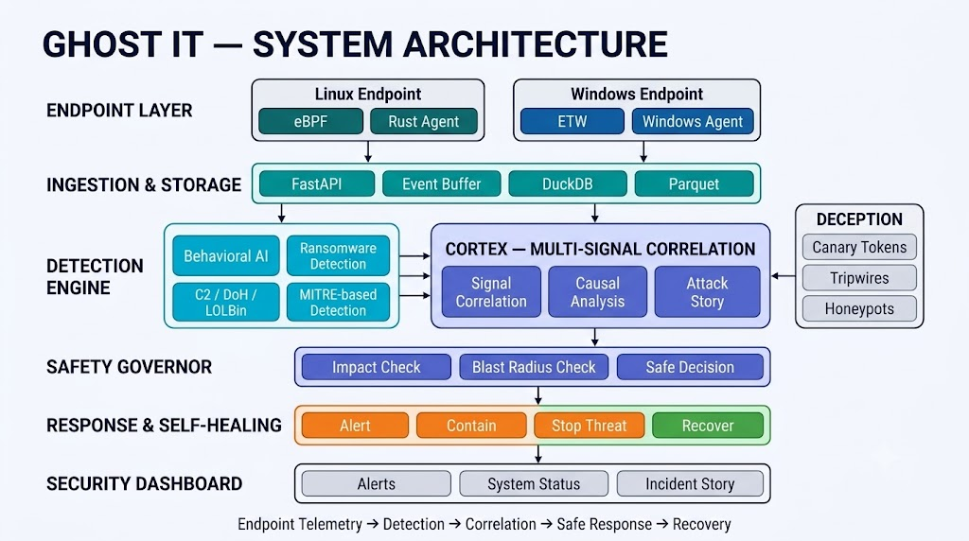
08
Presentation-level view of the Ghost IT immune loop and its technical layers
TECHNICAL MAPPING
Sense
Collect
Detect
Understand
Respond
Heal
Trust
Current deployment: Docker Compose • AWS Lightsail Mumbai
Ghost Layer • Ghost IT
B.Tech CSE (AI & ML

Slide 9
Hardware, Software Requirements & Gantt
09
09
Build constraints and the 22-week hardening-to-scale roadmap
Hardware
22-WEEK ROADMAP
• Modest SME endpoint hardware
• Linux / Windows endpoints
• AWS Lightsail for current server
• CPU/RSS limits are explicit design constraints
1
2
3
4
5
6
7
8
9
10
11
12
13
14
15
16
17
18
19
20
21
22
P1
Harden existing system
Backup • TLS • API auth • CI
P2
Pilot validation
Load test • SLI/SLO • GraphSAGE
Software
• Rust + eBPF
• Python + scikit-learn
• DuckDB + Parquet
• FastAPI + React
• Docker Compose
• Prometheus / Grafana
P3
Scale architecture
Kafka/Postgres • Kubernetes • FL
P4
Advanced capability
PMU/PT • LKRG • Firecracker
Success targets: <1s ransomware detection • <2% FP target • <0.5% CPU target • <80MB RSS target
Ghost Layer • Ghost IT
B.Tech CSE (AI & ML

Slide 10
Attack Scenario — How Ghost IT Defends
10
10
Ransomware scenario: what the attacker does and how Ghost IT contains the threat
1. WHAT THE HACKER DOES • RANSOMWARE ATTACK
1 Initial Access
2 Reconnaissance
3 Malicious Activity
4 Ransomware Behavior
5 Persistence
6 Impact
.Phishing, exploit or weak password gives
the attacker entry
Scans for valuable files, credentials and
other machines.
Runs malicious processes, changes files
and may move laterally.
Encrypts / renames files, drops ransom
notes and may attempt C2.
Creates startup entries or changes
configuration to remain on the system.
Files become unavailable; operations may
be disrupted or data exfiltrated.
2. HOW GHOST IT ACTS • SIX-LAYER WORKFLOW
1. SENSE
2. COLLECT
3. DETECT
4. UNDERSTAND
5. RESPOND
6. HEAL
Observe endpoint activity
• eBPF (Linux) / ETW (Windows)
• processes, files, network, system calls
Capture + transport events
• structured events
• hot buffer + Parquet
• durable outbox
Find suspicious activity
• behavioral AI
• ransomware / C2 / LOLBin / DoH
• deception triggers
Correlate + reason
• multi-signal fusion
• Cortex attack-chain reconstruction
• MITRE mapping
Contain the threat
• alert / isolate / suspend
• tiered response
• simulation by default
Restore healthy state
• remove persistence
• repair configuration
• verify and resume monitoring
3. STEP-BY-STEP VISUAL FLOW • RANSOMWARE SCENARIO
1
Malicious file executed
2
File encryption starts
3
Deception triggered
4
C2 connection attempt
5
Attack chain understood
6
Autonomous response
7
Self-healing
Sense + collect process execution.
Detect abnormal writes and entropy change.
Canary access raises a high-confidence signal.
C2 / DoH detector flags suspicious traffic.
Cortex correlates behavioral, ransomware and network signals.
Contain, alert and suspend when configured.
Remove persistence, repair state and verify recovery.
4. FINAL RESULT
WITHOUT GHOST IT
Files encrypted • system compromised • possible exfiltration • operational disruption
WITH GHOST IT
Threat detected <1s for proven ransomware case • process contained • persistence repaired • healthy monitoring resumes
Ghost Layer • Ghost IT
B.Tech CSE (AI & ML)

Slide 11
Module-wise Implementation Progress
11
Current implementation status — built, proof-of-concept, and roadmap are clearly separated
MODULE
AREA
WHAT IS IMPLEMENTED
STATUS
C1 / C9
Endpoint telemetry
Linux eBPF + Rust; Windows ETW
BUILT
C2 / C8
Behavioral AI
Local Isolation Forest + inference path
BUILT
C3
Deception
Canary tokens, tripwires and honeypot architecture
BUILT / PoC
C4 / C17
Causal Cortex
Attack-chain fusion + correlation; GraphSAGE training remains future
BUILT / MATURITY
C5 / C7
Pipeline & transport
Custom TCP, hot buffer, DuckDB + Parquet, durable outbox
BUILT
C6
Self-protection
Watchdog, persistence protection and configuration recovery
BUILT
C10
Federated learning
FLTrust mechanism demonstrated as a PoC
PoC
C11 / C12
Trust & privacy
PQC hybrid signing + India-first DPDP design
BUILT
C14 / C15
Specialized detection
C2/LOLBin/DoH + ransomware EMA
BUILT
C18 / C19
Advanced hardware security
PMU/Intel PT and kernel integrity are roadmap items
ROADMAP
Current position: working system / pre-pilot. Production hardening, scale validation and real multi-customer FL remain next-stage work.
Ghost Layer • Ghost IT
B.Tech CSE (AI & ML)

Slide 12
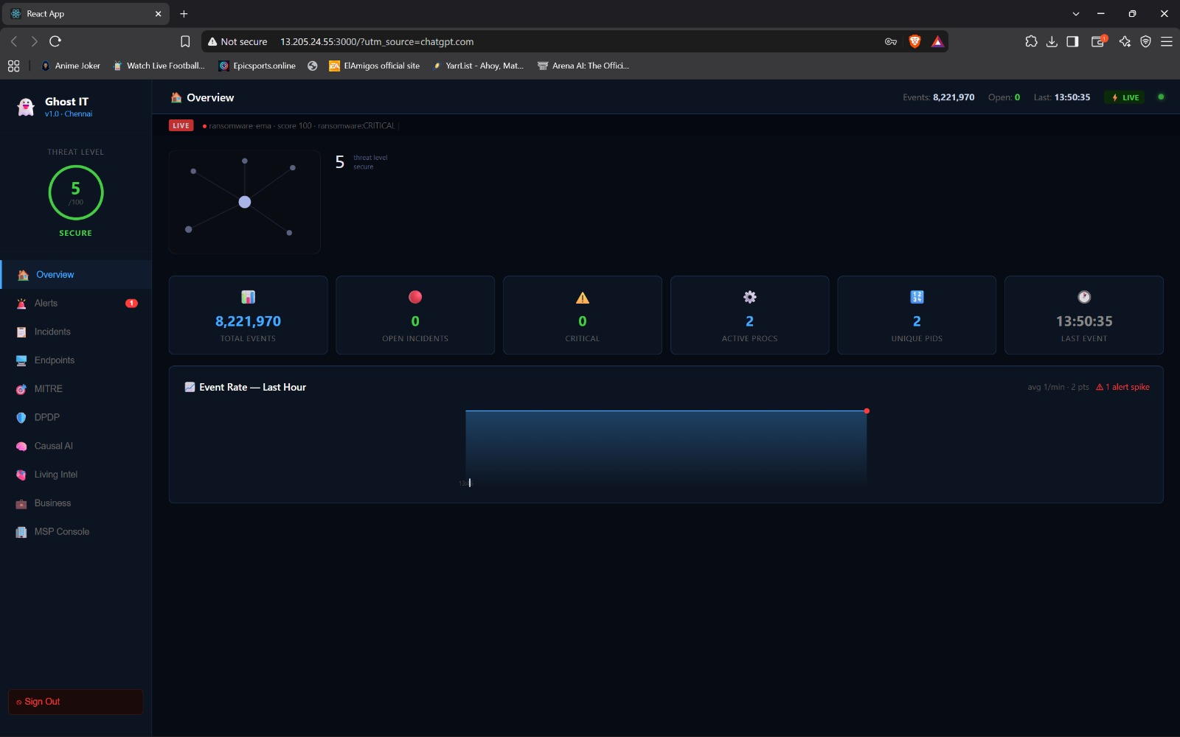
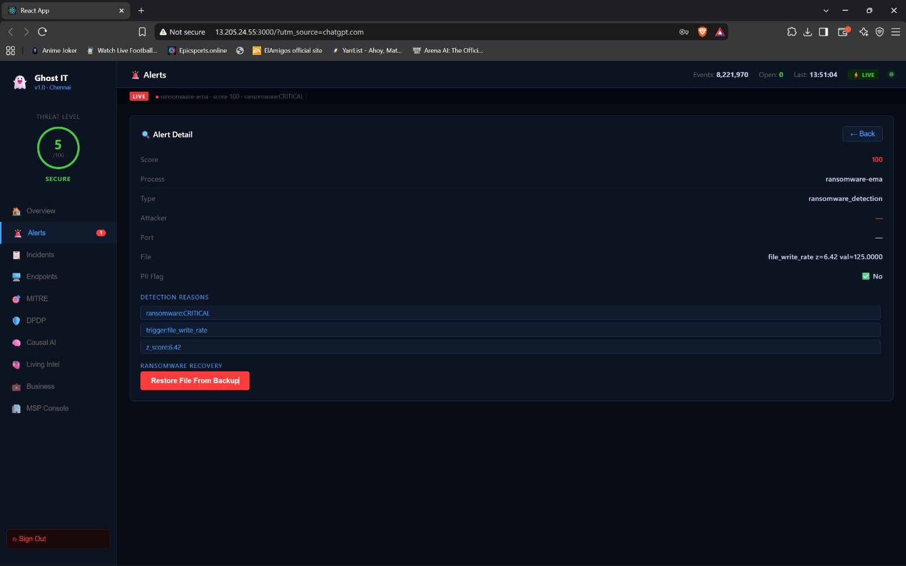
Prototype & Working Demonstration
12
The dashboard turns technical detections into an operator-readable incident
Threat-level view
Incident severity, event counts and current system state are visible to the operator.
Alert detail
Ransomware EMA alert shows score, detection reasons and recovery-oriented actions.
Prototype evidence
Dashboard + ransomware alert detail + incident narrative workflow
Ghost Layer • Ghost IT
B.Tech CSE (AI & ML)

Slide 13
Testing Progress, Results & Challenges
13
Measured evidence from the current development environment
<1 sec
41 / 41
0 / 10
Ransomware detection
Automated checks
Observed benign-test FP
500+ / 3s
~2%
~127 MB
Event throughput
CPU on live dev VM
RSS on live dev VM
ENGINEERING FIXES / CHALLENGES
•
Pipeline sequence reset
Detection recovery added after pipeline restarts.
•
Dashboard API configuration
Split / corrected backend URLs for browser login.
•
Event path resolution
Added /proc/pid/fd fallback; 100% success across 200 samples post-fix.
•
Tamper alert noise
Heartbeat watchdog reduced repeated tamper alerts.
Important: CPU/RSS figures are development-environment measurements and require broader scale validation.
Ghost Layer • Ghost IT
B.Tech CSE (AI & ML)

Slide 14
Startup Evaluation & Evolution
14
Why Ghost Layer can move from a project into a product journey
STARTUP EVALUATION
Ghost Layer has a clear path from an academic cybersecurity project toward a commercial SME security platform because the current system already demonstrates a real technical foundation: endpoint telemetry, behavioral detection, ransomware response, deception, causal reasoning, observability and recovery workflows. The product idea addresses a recurring business problem—SMEs need stronger endpoint protection while operating with smaller security teams, tighter hardware budgets and India-focused data requirements. Its potential differentiation is the immune-loop architecture, where sensing, collection, detection, understanding, response and healing are designed as one continuous system rather than isolated tools. The present stage should be described honestly as a working system / pre-pilot: production hardening, broader scale testing, customer validation and repeatable deployment are still required before commercial scale. The next business step is therefore an SME pilot that can validate measurable security outcomes, deployment effort and a repeatable recurring-revenue model.
EVOLUTION PATH
01
Research
02
Working System
03
SME Pilot
04
Product
05
Scale
Next proof point: SME pilot → measurable outcomes → repeatable deployment → sustainable product business
Ghost Layer • Ghost IT
B.Tech CSE (AI & ML)

